Slide 1
Drown Prevention & Adaptive Swimming

Slide 2
What is Drowning?
World Health Organization: "the process of experiencing respiratory impairment from submersion/immersion in liquid“
Fata vs. Non-Fatal Drowning
Suffocation leads to fatal drowning

Slide 3
How long does it take?
IN THE TIME IT TAKES TO...
• Cross a room for a towel (10 seconds), a child in a bathtub can be submerged.
• Answer the phone (2 minutes), a child can lose consciousness.
• Sign for a package at the front door (4-6 minutes), a child submerged in a tub or pool can sustain permanent brain damage

Slide 4
What is Dry Drowning?
Dr. Mary Aitken, Arkansas Children’s Hospital
Not a well-accepted medical term. In fact, the World Congress on Drowning, an international advisory body, discourages the use of the term.
In many cases, people who are rescued by lifeguards recover quickly, but those with symptoms like respiratory distress, cough, and/or vomiting will require evaluation and emergency department care.
Parents should always get medical evaluation if they are worried, but should know that most symptoms develop immediately, and that the frightening cases shared in the media are rare cases where symptoms develop 4-6 hours after the event.
In these cases, the children show symptoms that indicate that there is a problem. Any child that has persistent or worsening cough, fast breathing, vomiting, fever, or changes in mental status after being submerged in water should be taken to the nearest emergency room for immediate evaluation.

Slide 5
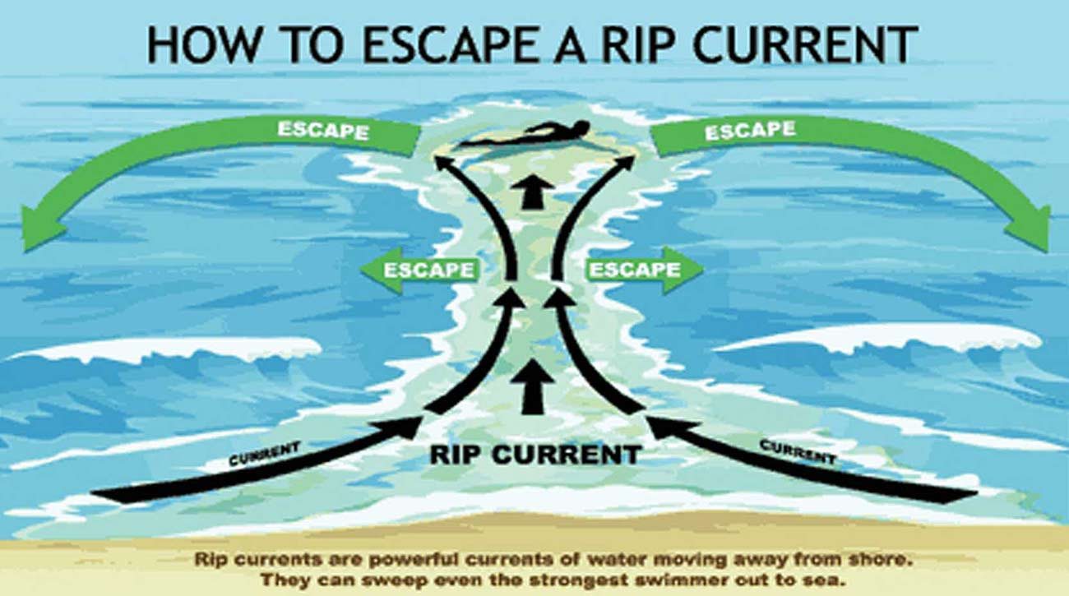
Rip Currents
Rip current speeds are typically 1-2 feet per second
Can sweep even the strongest swimmer out to sea
Over 100 drownings due to rip currents occur every year in the United States
More than 80% of water rescues on surf beaches are due to rip currents
https://www.washingtonpost.com/news/capital-weather-gang/wp/2018/04/30/after-tragedy-at-the-outer-banks-here-are-3-ways-to-stay-safe-at-the-beach/?noredirect=on&utm_term=.ecd0dd2bf89f
https://www.youtube.com/watch?v=viKb5Ny4OWk

Slide 6
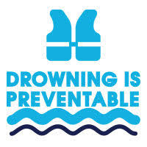
100% Preventable
No Silver Bullet
Layers of Protection
The Safer 3
Safer Water
Safer People
Safer Response

Slide 7
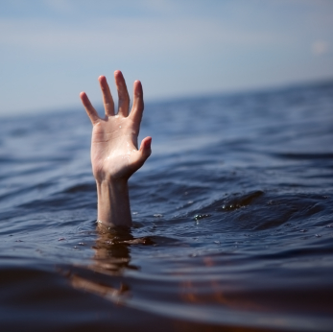
Adults: Never Swim Alone
4 out of 5 drownings are ages 15 and older (80%)
Lack of swimming skills
Alcohol
Dangerous activities

Slide 8
We are missing an important conversation
Drowning the #1 cause of accidental death for children ages 1-4.
Drowning is the #2 cause of accidental death for children ages 4-14.
For every 1 child that has a fatal drowning, there are 5 more that survive, and 50% suffer complications such as brain damage
Those with Autism are 160 times more likely to drown, it is #1 cause of accident death.

Slide 9
Swift and Silent
There is no call for help
No waving of the hands
Less than 60 seconds
A Texas mother was charged after a witness reportedly claimed she was using her phone while three of her children drowned in an apartment complex pool in 2015.
https://www.youtube.com/watch?v=7eKUDc2qeeY

Slide 10
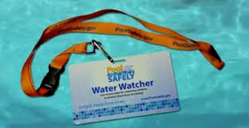
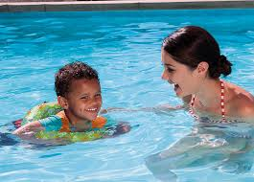
Touch Supervision
Never leave a child unattended near water
Touch Supervision even with Lifeguards present
Water Watcher on duty
Know CPR!
Do not use floatation devices as substitutes for supervision

Slide 11
Life Jackets
NO FLOATIES!
Choosing the right size
Choosing the right type
How to make sure it fits
Does not cause regression

Slide 12
Home Pools
The home should be isolated from the pool with a fence at least 60” tall, with a self-closing, self-latching gate. The gate should open away from the pool, and should never be propped open.
Doors and windows should be alarmed to alert adults when opened. Doors should be self-closing and self-latching.
Power-operated pool safety covers are the most convenient and efficient. Solar/floating pool covers are not safety devices.
Keep a phone at poolside so that you never have to leave the pool to answer the phone, and can call for help if needed.
Learn CPR and rescue breathing.
Keep a life-saving ring, shepherd’s hook and CPR instructions mounted at poolside.
Remove toys from in and around the pool when not in use.
Don’t use floating chlorine dispensers that look like toys.
Instruct babysitters about potential pool hazards, and emphasize the need for constant supervision.
Responsibilities of pool ownership include ensuring children in the home learn to swim, and that adults know CPR.

Slide 13
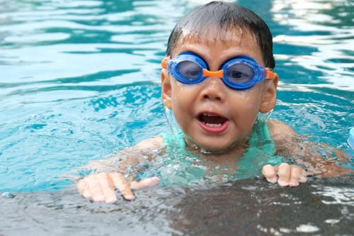
Reach for the Wall
The wall is the safest place in the pool
The stairs are not safe
Teach children to enter and exit using the wall

Slide 14
Swim Lessons
Decrease the risk of drowning by 88%!
No on is DROWNPROOF
Nurturing and positive approach

Slide 15
We Welcome Students with Special Needs!
We are proud to be a swim school that offers life-saving skills and swim instruction to clients of all ages with a variety of special needs.
Our senior coaches are trained to handle:
Autism Spectrum
Seizure Disorders
Cerebral Palsy
Down's Syndrome
Sensory Disorders
Speech and Language Disorders, including Non-verbal Swimmers
Physical disabilities
Apraxia

Slide 16
Autism Spectrum
Drowning is the #1 cause of accidental death, for all ages, on the Autism Spectrum
91 percent of all wandering-related deaths among autistic children were due to accidental drowning, according to the National Autism Association.
According to the Autism Spectrum Disorder Foundation (ASDF), “Swimming provides invaluable therapy for children with autism, as well as providing a social outlet for them. Swimming can help an autistic child improve their speech, coordination, social skills, self-esteem, and cognitive processing.”

Slide 17
Online Profile
Safety Before Skill partners with Arkansas Children's Hospital and the Dennis Developmental Center to provide additional internal coach education regarding special needs, social stories and a questionnaire for parents to communicate effectively with their coach.
We offer each parent the opportunity to complete the "Special Needs Swimmer Profile," designed by Clinicians at the ACH Dennis Developmental Center, online. It is a valuable communication tool between the parent and coach.

Slide 18
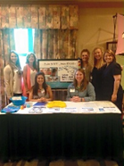
Best Practices
Safety Before Skill is a proud sponsor of the Team Up for Autism Conference sponsored by Arkansas Children’s Hospital.
Our staff attend in order to keep pace with the latest statistics and interventions regarding Autism Spectrum Disorder.
Members of our team attend the education sessions, network with other organizations that work with special needs and most importantly, visit with special needs families and clinicians.

Slide 19
We are Certified
Safety Before Skill is a certified Swim Angelfish swim school.
Swim Angelfish is an adaptive swim program that provides training and certifications for special needs and autism swim lessons.
The certification consists of 16 hours of classroom study and monthly continuing education.

Slide 20
Starfish Aquatics Institute
We are also certified with the internationally recognized Starfish Aquatics Institute Children with Challenges and Adapted Aquatics programs.
The Children with Challenges Course was developed as a collaborative effort between the Aquatic Therapy and Rehab Institute (ATRI), USA Swimming, USA Swimming Foundation, and Starfish Aquatics Institute (SAI).
Adaptive Aquatics Certification covers 21 disabilities

Slide 21
Safety Before Skill Benchmarks
We educate parents and students on:
Asking Permission
Touch Supervision
Lifejacket Use
Rescue Skills, Reach and Throw
Reach for the wall
Roll to Float
CPR

Slide 22
Adaptive Swimming
Modifying
teaching environment
Skills
Equipment
instructional strategies

Slide 23
Attention, Balance and Coordination
Organize the Central Nervous System
Vestibular System
Hard Input on the wall
Spinning
Drifting and swinging
Up and Down

Slide 24
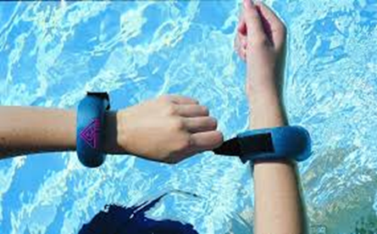
Sensory Processing
Organize the central nervous system first
Consider Processing Time Loop
Short, concise commands
Consideration of lights, sounds
Social stories
Feeling their body in the space - Weights and fins and paddles

Slide 25
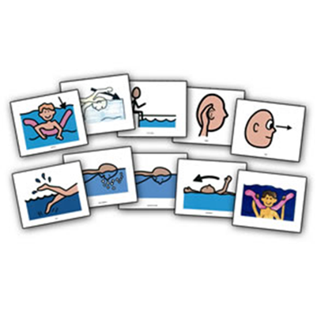
Non-Verbal
Use of photo cards
Sign language
Visual cues and representations
Ritual and routine

Slide 26
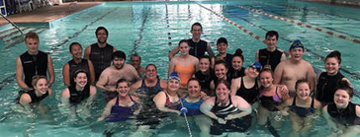
Special Olympics
Safety Before Skill is a proud sponsor and supporter of the Special Olympics of Arkansas
Our own Coach Casey Brown, with a Master’s Degree in Special Education, coaches our Special Olympic team, The Water Dragons! We share our pool with them and our coaches volunteer as instructors as part of their training.

Slide 27
What can you do?
Remember that Drowning is Swift and Silent
Never Swim Alone
Assign a water watcher/ Touch Supervision
Teach Them to Ask permission – Pool Please?
Always wear a lifejacket in or near the water
Take swim lessons
Learn CPR
Place barriers: fences, locks and alarms
Do not leave toys around the water
Educate caregivers
https://www.youtube.com/watch?v=PxJZLAacUOY

Slide 28
Resources
Safety Before Skill: www.safetybeforeskill.com
Centers for Disease Control: https://www.poolsafely.gov/
National Drowning Prevention Alliance: https://ndpa.org/

